Slide 1
The ‘Battle of Swansea’
Dr Huw Griffiths
and
Dr Susan Davis
DARPL

Slide 2
How to use these slides
Please use these slides along with the teacher notes
They are designed to stimulate conversations and further research
Teachers should work with learners in exploring the materials and adapt them according to needs / age of learner etc.
There is further reading / information on teacher notes page

Slide 3
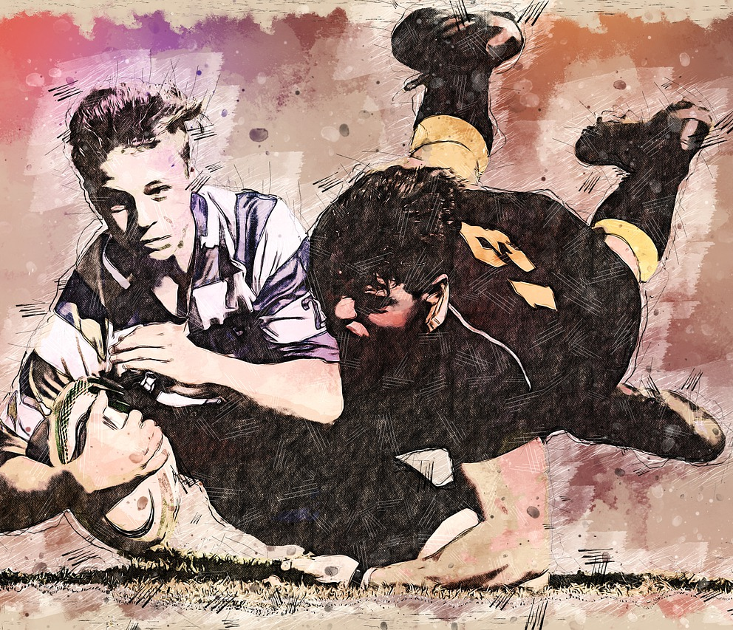
What is the connection between?
Swansea, Wales
Rugby
Nelson Mandela
Apartheid
South Africa?

Slide 4
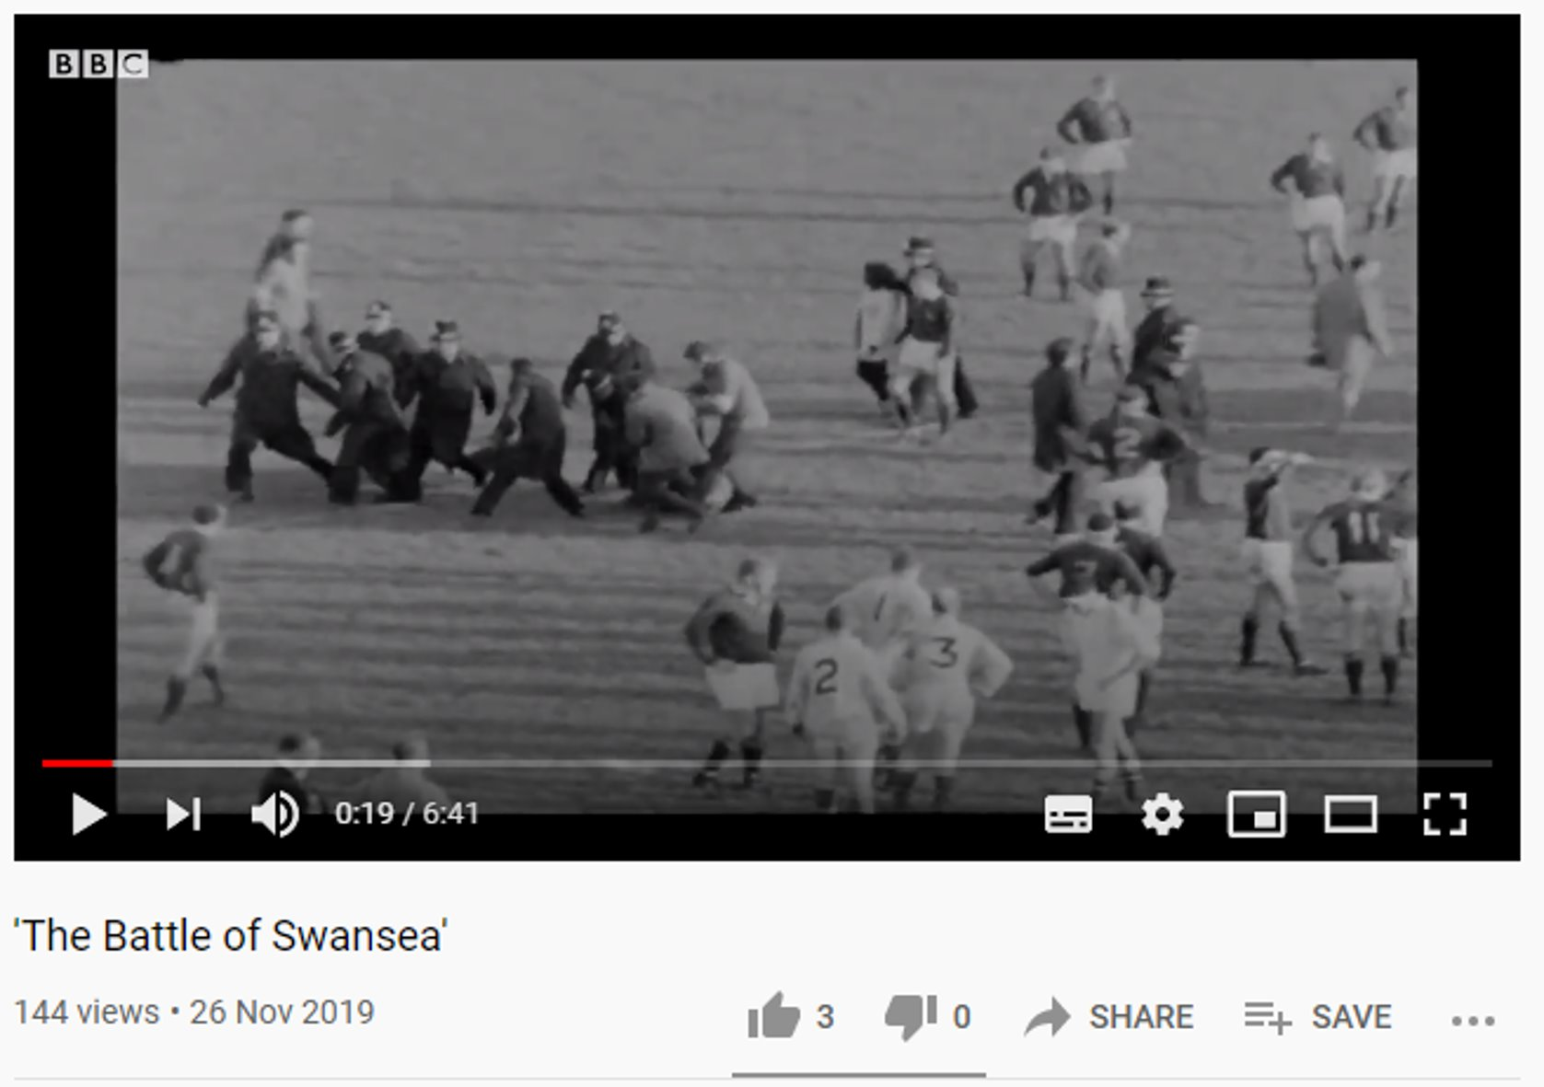
The BattLE OF SWANSEA
Video credit : BBC on
https://youtu.be/UNg0WI2aOdY

Slide 5
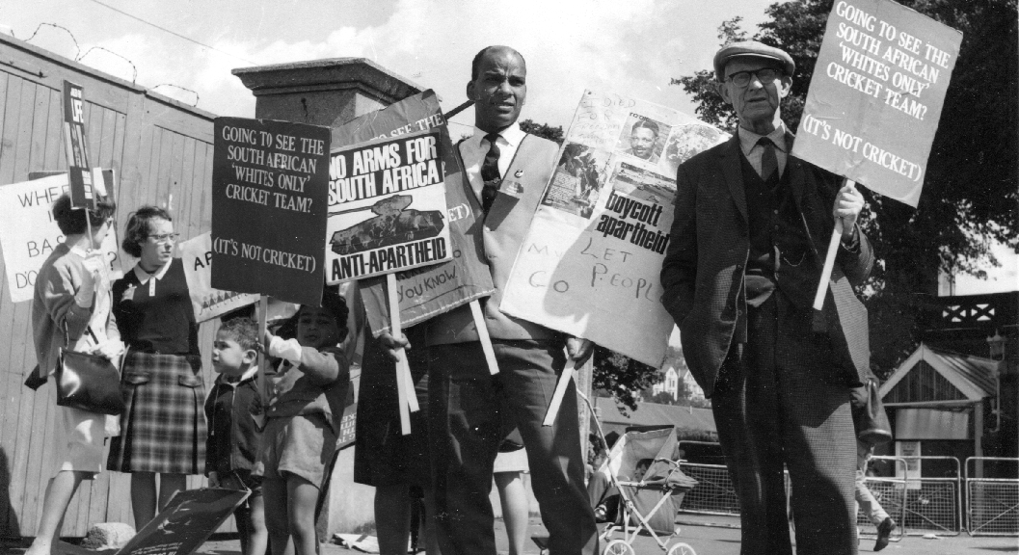
Protestors hold Up signs against ApartheiD

Slide 6
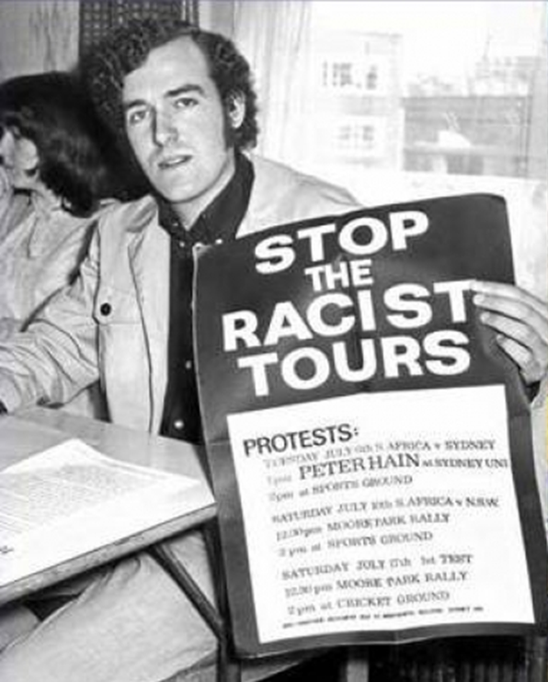
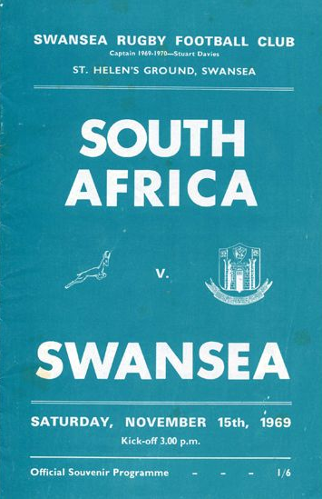
Peter Hain
photo credit:
‎www.liberalhistory.org.uk/wp-
content/uploads/2014/10/74_Spring_2012.pdf
Notes:
Led by Peter Hain, who would later become Lord Hain and a member of parliament for Neath, during the protest in Swansea he was a 19-year-old student and an ardent anti racism campaigner. The world was slowly waking up to the true horror of apartheid regime in South Africa - however rugby was not listening.
"Frankly it was a dialogue with the deaf between anti-apartheid protestors, and players and spectators," said Lord Hain. "We tried to engage with them to say they were collaborators with the most evil and racist system in the world, but they just thought we were interfering with their game - and they really hated us for it."

Slide 7
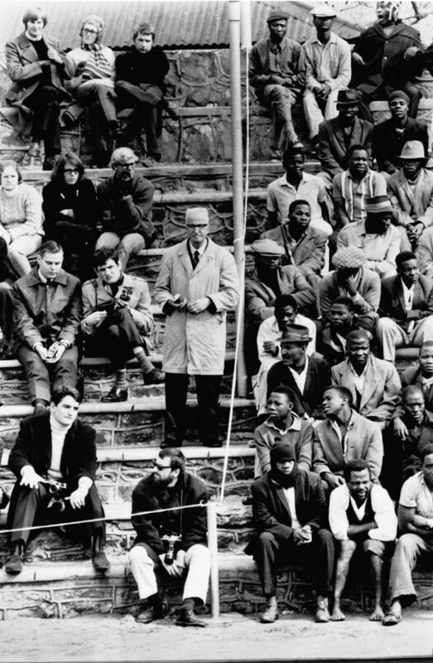
Apartheid in South Africa
Flickr.com: www.unmultimedia.org/photo/

Slide 8
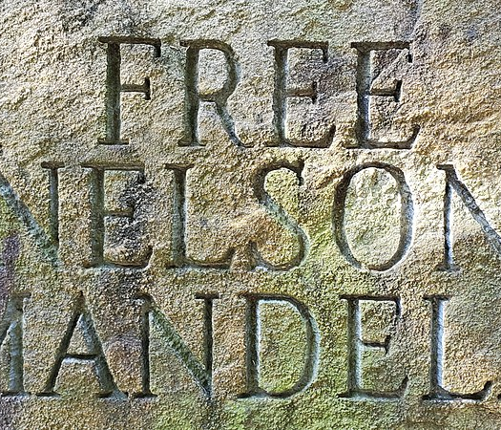
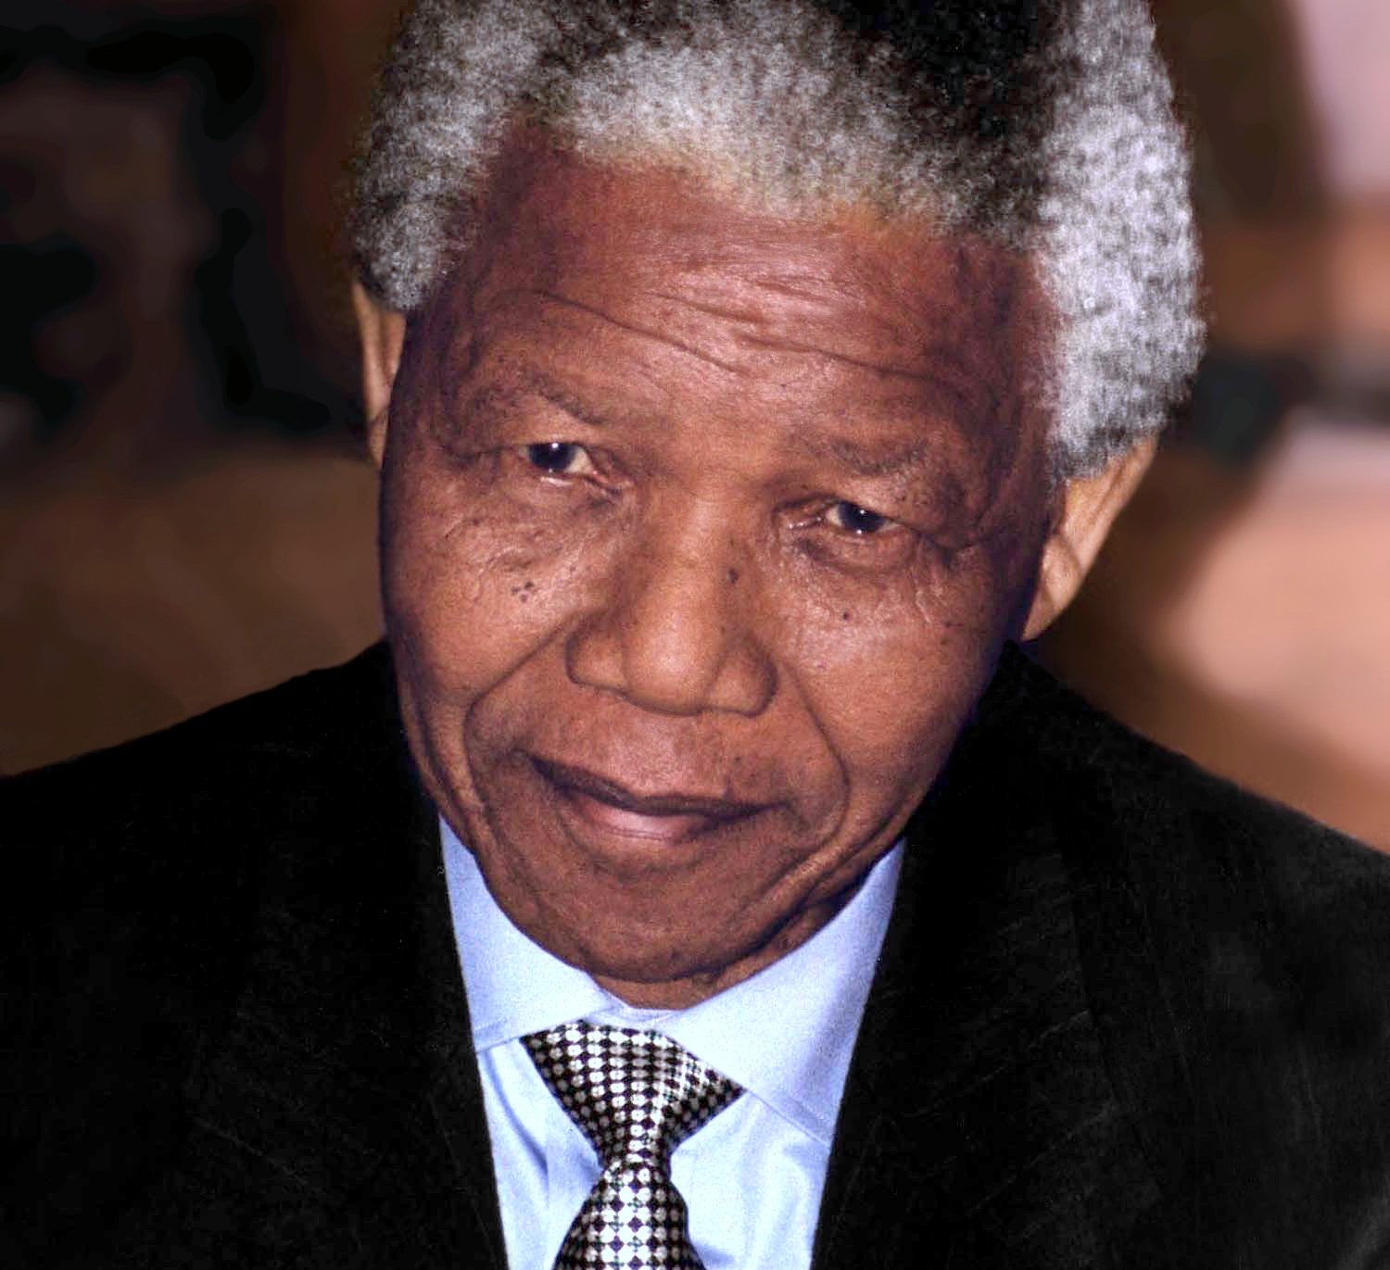
Nelson Mandela

Slide 9
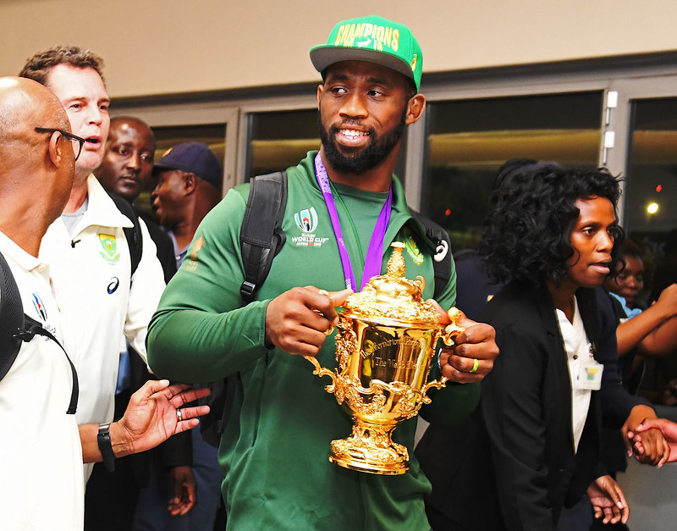
In 2018, Siya Kolisi was the first black man to be appointed captain of the Springboks Rugby team. He then leD the South African team to victory in the 2019 Rugby World Cup Final against England.
Flickr.com: GovernmentZA

Slide 10
Please note, these materials have been co-created for DARPL and should not be re-used out of context.
Please use the accompanying teachers notes with this power point.
For enquiries contact darpl@cardiffmet.ac.uk

